Slide 1
Project Title – Seasonal Agriculture Performance Analysis
[Student Name - Abhinav Prasad
College Name - MIT World Peace University]
AICTE STU ID : (STU6a317fd386f261781628883)
1

Slide 2

PROBLEM STATEMENT
(Agricultural activities are influenced by seasonal variations in environmental conditions, farming practices, resource availability and market conditions. As a result, agricultural performance may differ from one season to another. However, raw agricultural data does not clearly explain how agricultural performance changes across seasons or what patterns can be observed in different seasonal conditions. The problem is to analyze the given agricultural dataset and investigate seasonal differences in agricultural performance by identifying meaningful patterns, trends, relationships and variations within the available data.

Slide 3
Project Description
Research Objectives
Quantify seasonal yield differentials across major crop cycles including Kharif, Rabi, and Summer (Zaid) to detect historical bottlenecks.
Synthesize environmental indicators like seasonal rainfall anomalies, fertilizer intensity, and surface temperature against production metrics.
Build automated data cleaning and statistical aggregation pipelines that transform unstructured historical records into actionable intelligence.
Methodological Scope
Employs multivariate exploratory data analysis (EDA), anomaly detection, and regression algorithms to forecast seasonal performance.
Generates interactive visualizations and heatmaps to aid stakeholders in pinpointing optimal planting schedules.
Establishes an empirical baseline for data-backed crop selection, fertilizer allocation, and localized harvest planning.

Slide 4
WHO ARE THE END USERS?
Farmers & FPOs
Guides smallholder farmers and Producer Organizations on crop selection, sowing schedules, and seasonal resource budgeting to minimize yield losses.
Agritech Planners
Enables government bodies and policy planners to prepare seasonal food security reserves, drought buffers, and minimum support prices.
Supply Chains
Assists commodity buyers, cold storage facilities, and logistics firms in anticipating post-harvest volume spikes across seasonal corridors.
Agri-Researchers
Supplies verified seasonal performance indices to agronomists studying crop resilience against erratic microclimate shifts.

Slide 5


Technology Used
Python
NumPy
Jupyter Notebook
Matplotlib
Seaborn
9/14/2026 Annual Review

Slide 6
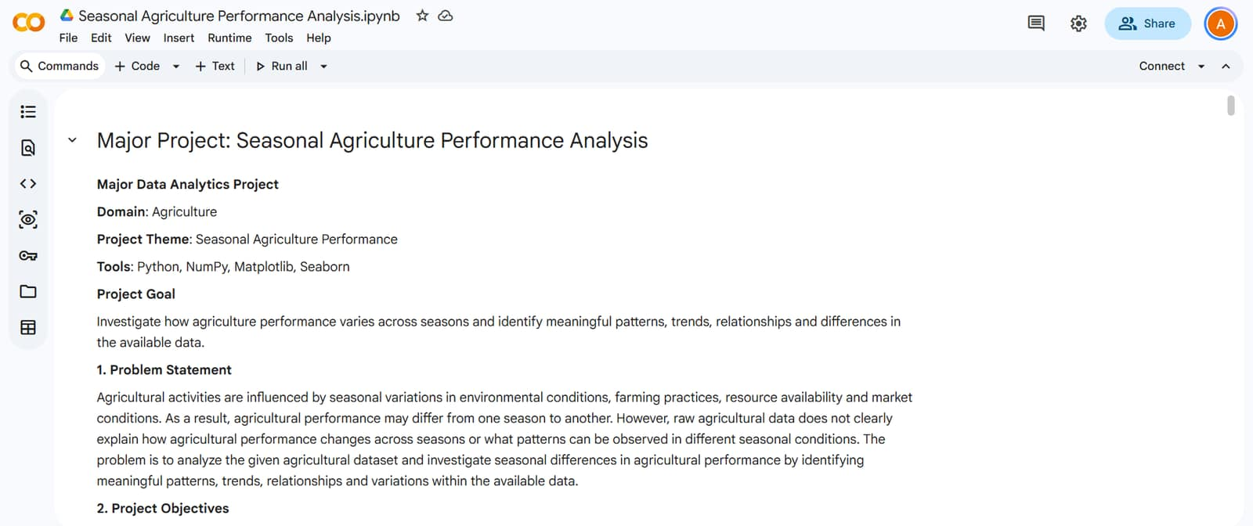
RESULTS

Slide 7
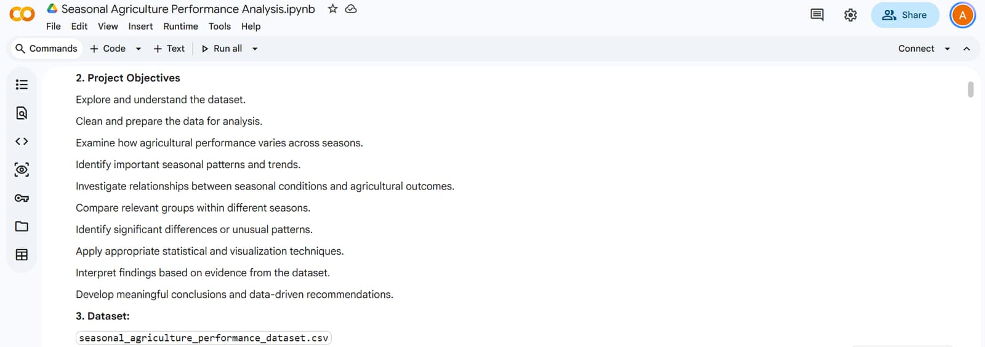
RESULTS

Slide 8
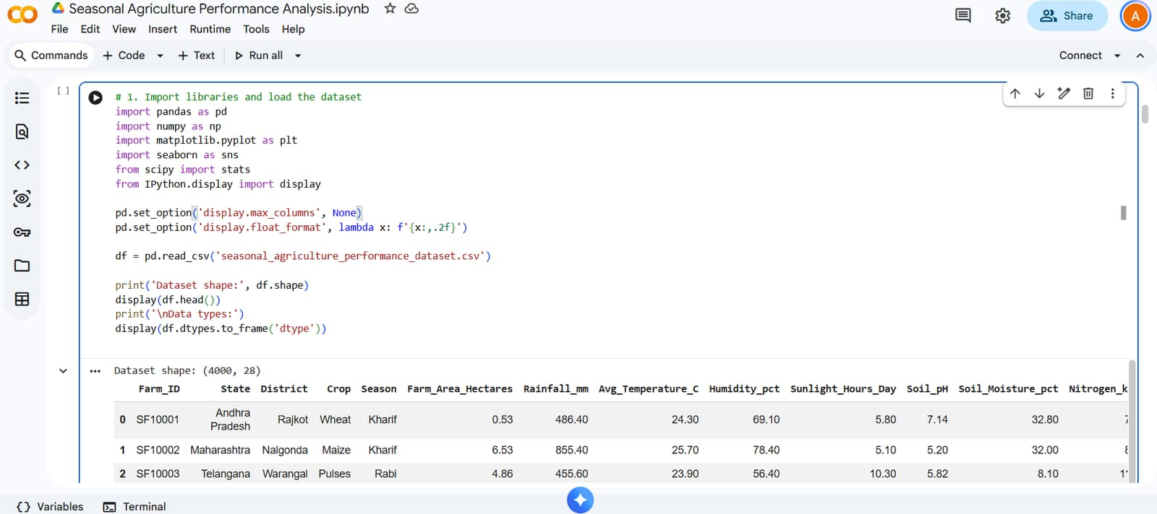
RESULTS

Slide 9
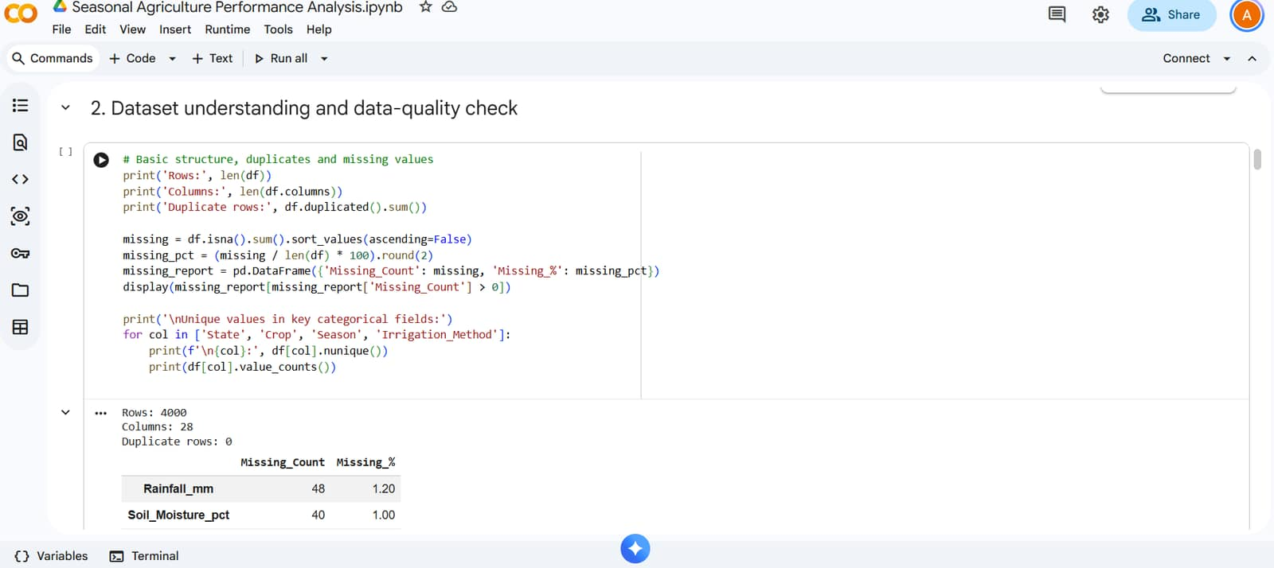
RESULTS

Slide 10
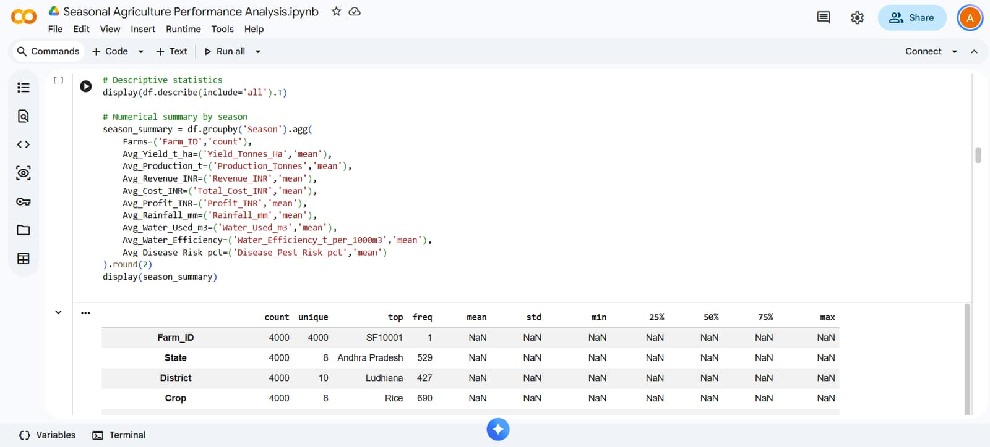
RESULTS

Slide 11
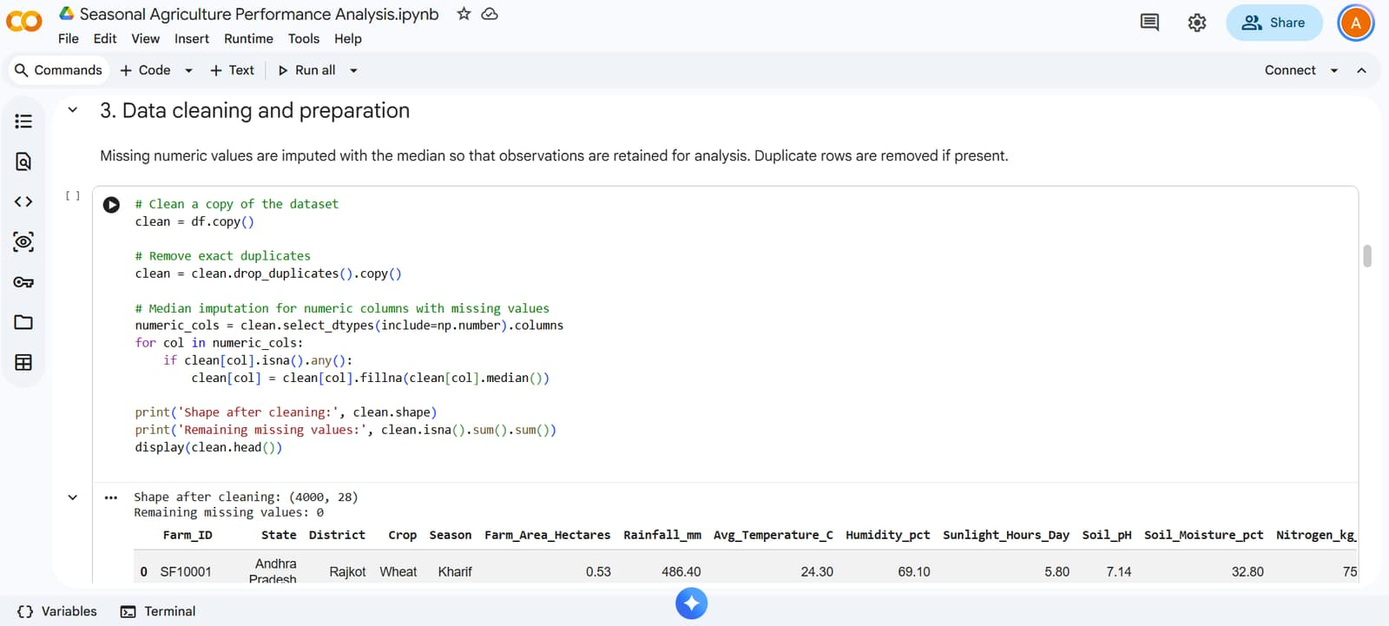
RESULTS

Slide 12
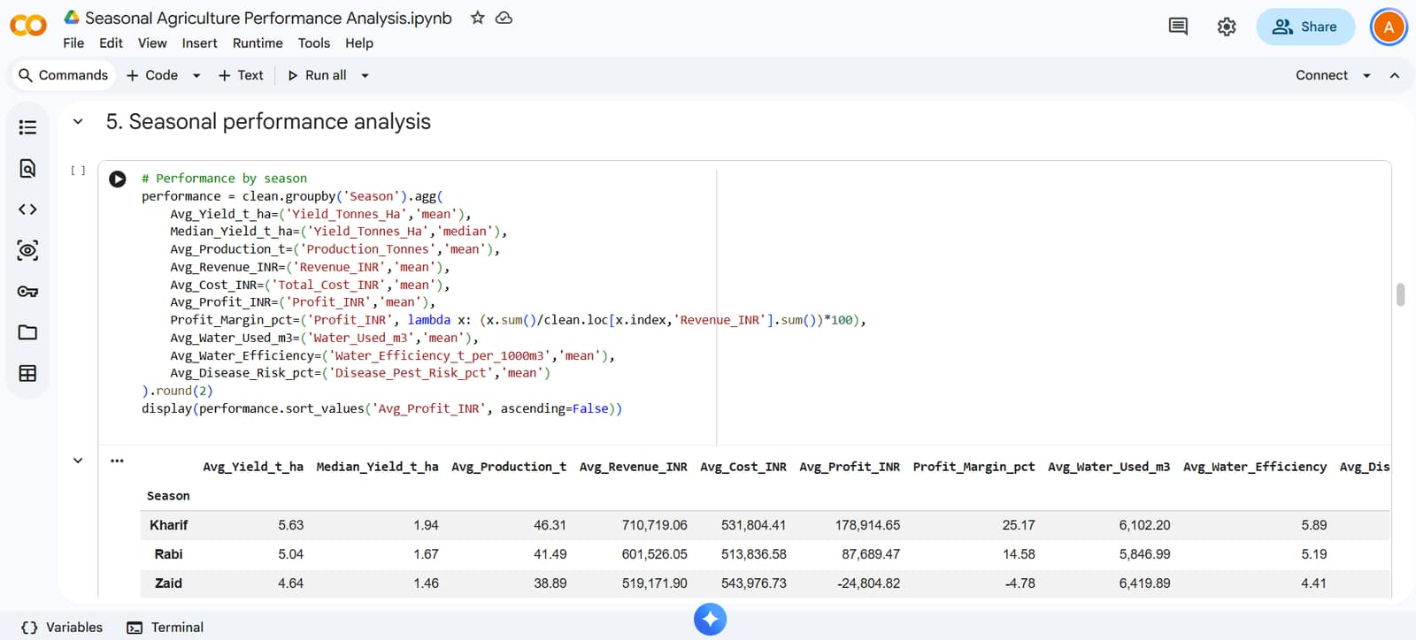
RESULTS

Slide 13
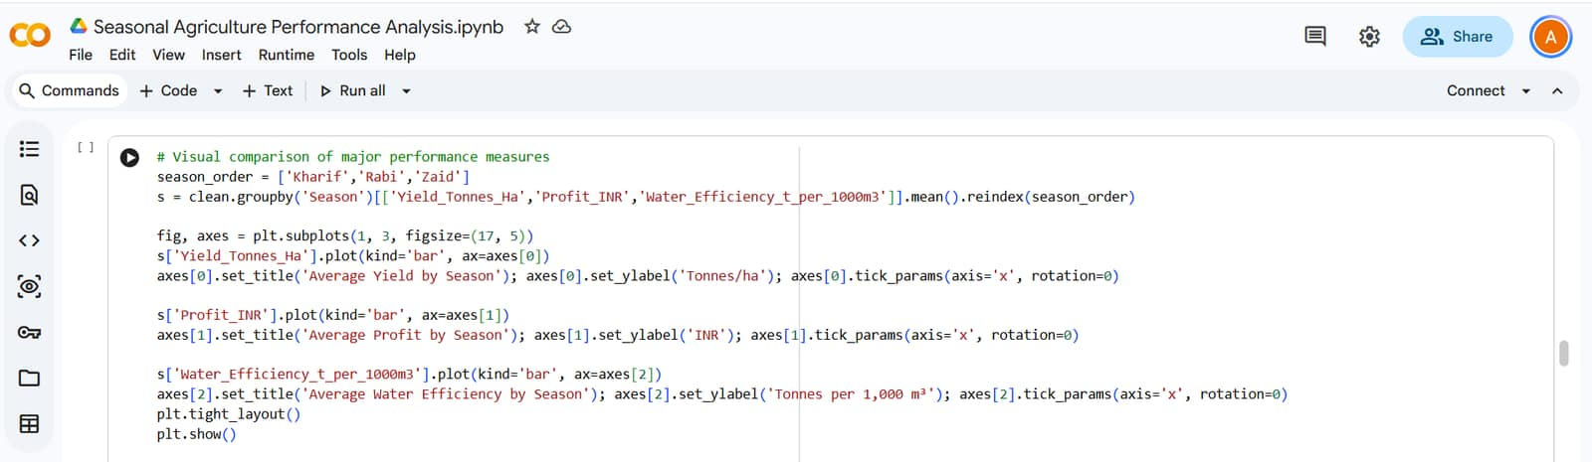
RESULTS

Slide 14
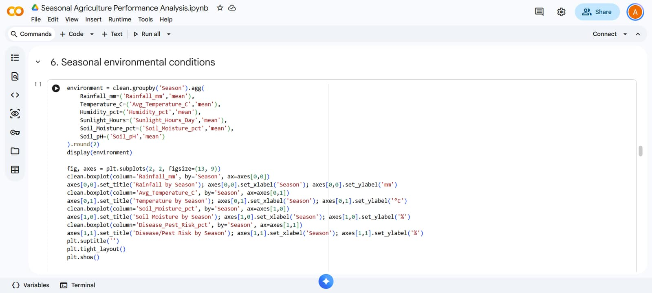
RESULTS
[Add screen shots of your code ]

Slide 15
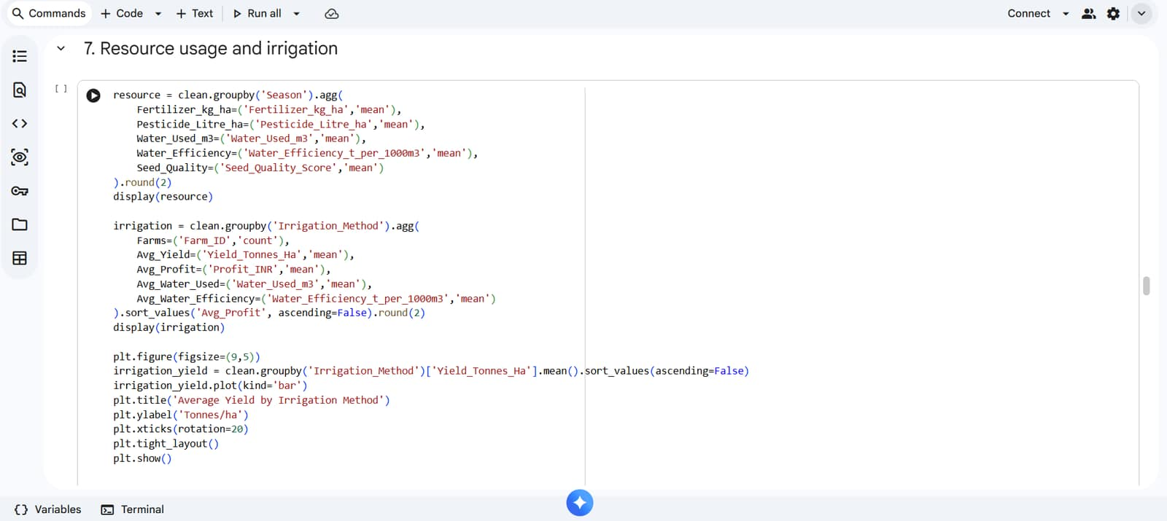
RESULTS

Slide 16
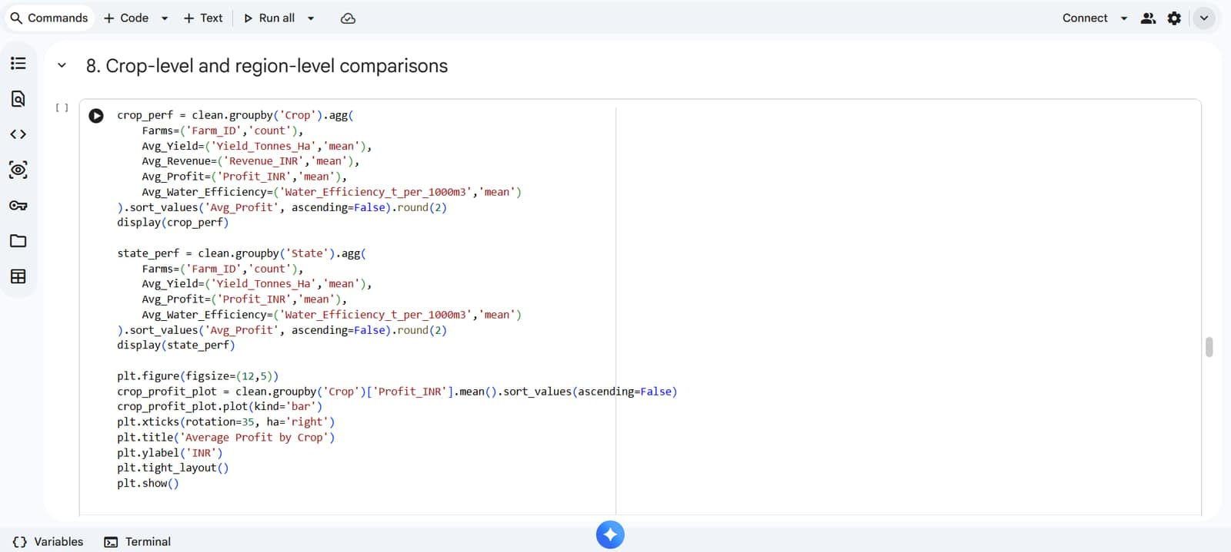
RESULTS

Slide 17
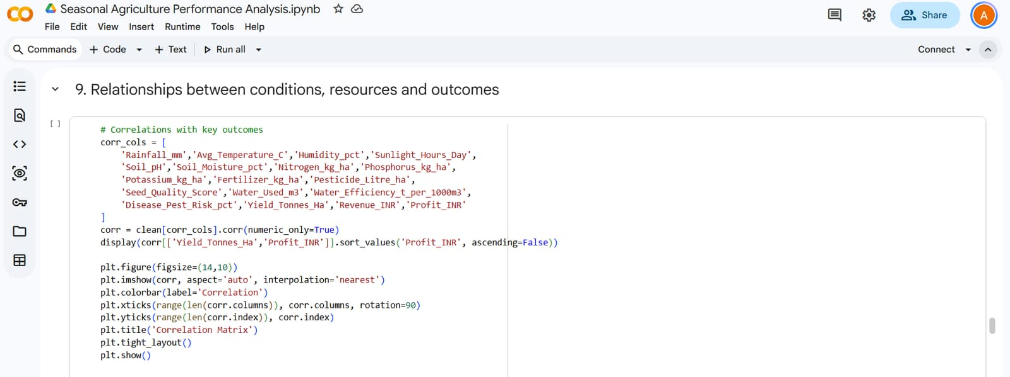
RESULTS

Slide 18
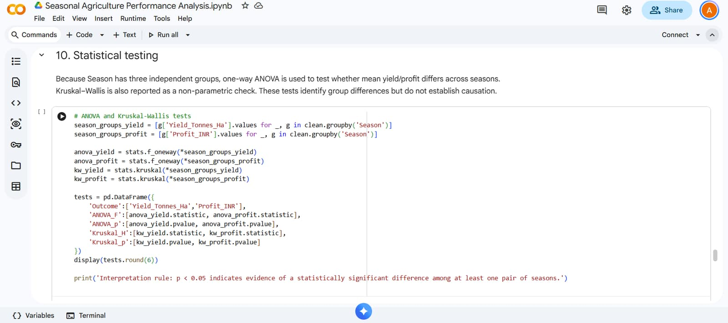
RESULTS

Slide 19
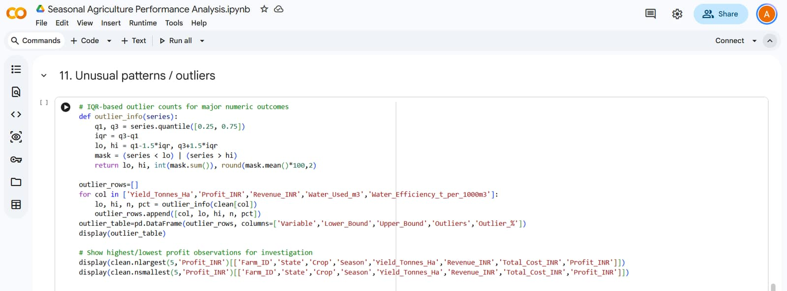
RESULTS
[Add screen shots of your code ]

Slide 20
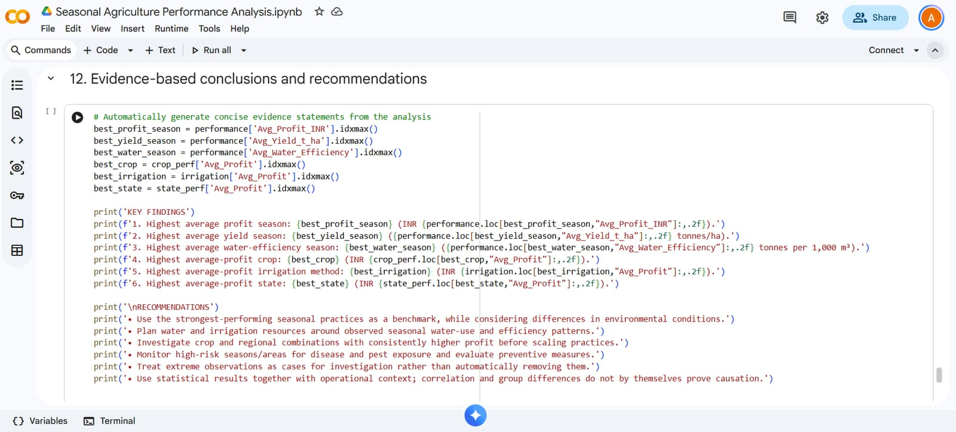
RESULTS

Slide 21
Future scope
Connect localized soil moisture probes and automated weather stations to stream micro-climate telemetry directly.
Deploy a localized voice-assisted mobile application enabling multilingual alerts directly to smallholder farmers.

Slide 22
GitHub Link
https://github.com/abhinavpd099/Seasonal-Agriculture-Performance-Analysis

Slide 23
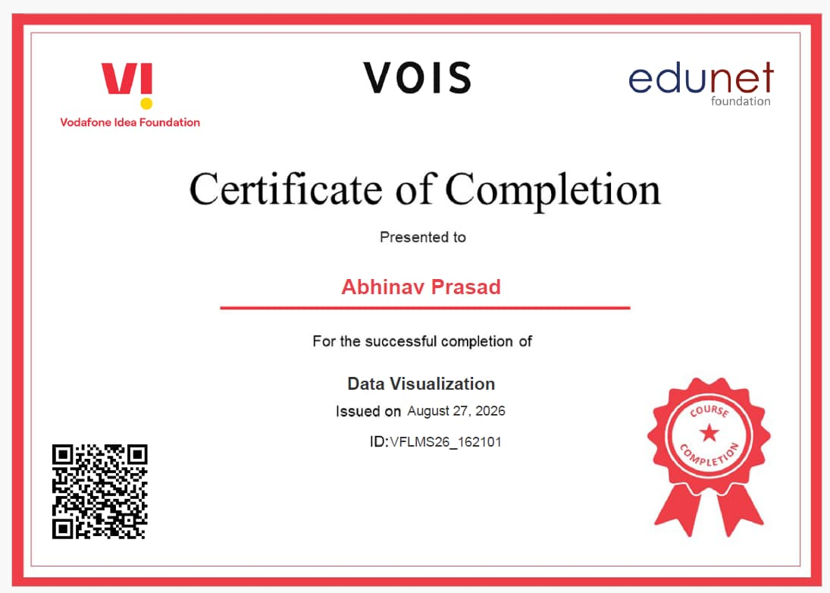
VOIS Course completion certificate - Course name- Data Visualization

Slide 24

Thank you
.
.

